Slide 1
I

Slide 2
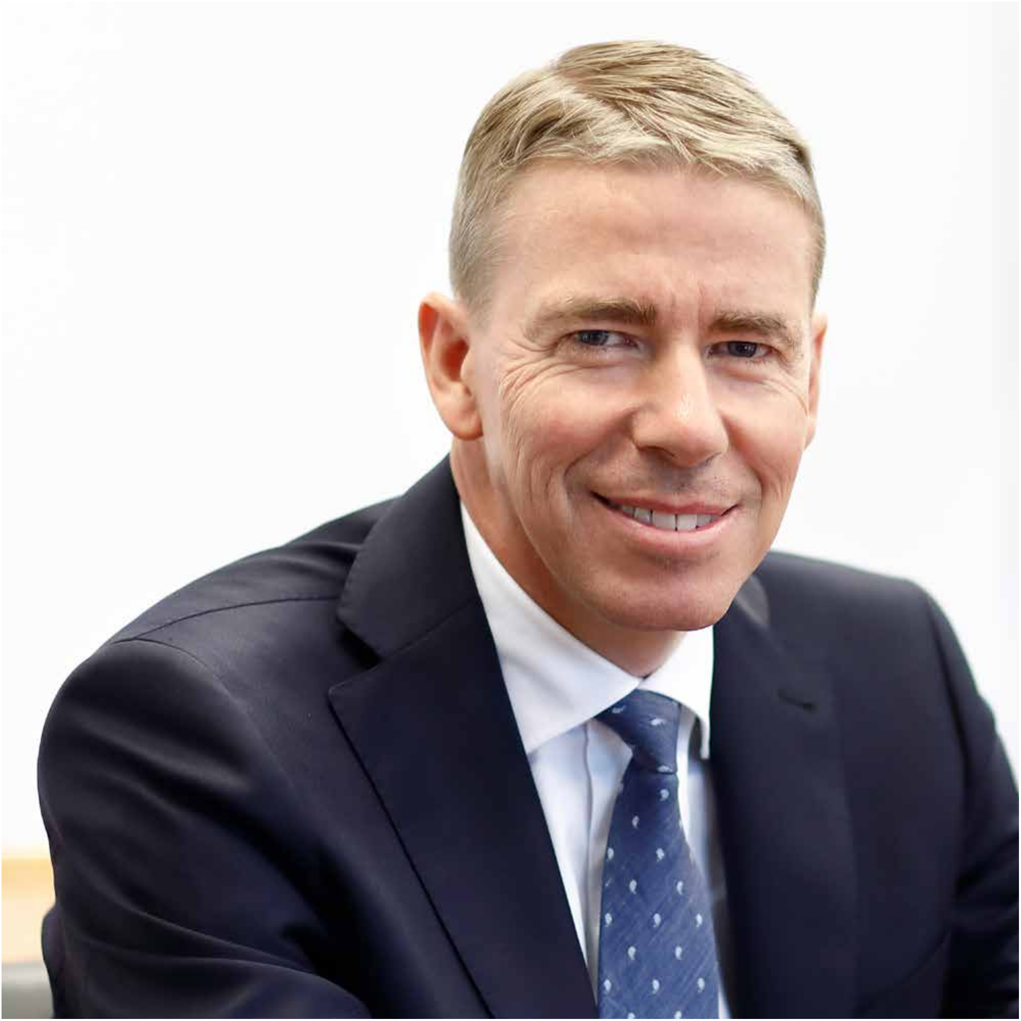
II
“It is every employee’s
responsibility – mine and yours – to know the Code of Conduct and abide by it in our daily work.”

Slide 3
To all Indutrade employees
Indutrade’s business philosophy – entrepreneurship and decentralised leadership – is one of the keys to the
company’s success and has been so since the start in 1978. Indutrade continues to grow through acquisitions of
well-run and profitable companies, which from day one share our values and our approach to doing business.
With more companies and more employees in more countries, we have a greater need to highlight and clarify –
both for ourselves and those in the world around us – the foundation for our approach.
A philosophy based on great freedom with responsibility puts high demands on every individual employee’s
integrity. Through professional, honest and ethical conduct, we are building a company culture in which we
effectively and credibly deliver good results and create value for colleagues, customers, suppliers and other
business partners. In this Code of Conduct we lay out a few essential and overarching principles and guidelines
which support our decision-making. It reflects who we want to be and how we want to be perceived.
It is every employee’s responsibility – mine and yours – to know the Code of Conduct and abide by it in our daily
work. I encourage you to discuss the Code of Conduct with your workmates, your manager, or with me and my
colleagues in Group Management. By keeping this discussion alive we further shape the company culture that
we are all proud of.
Bo Annvik, President and CEO
1

Slide 4
2
Business ethics
Employee
relationships
Acquire and
develop
Health and
safety
Human rights
Decentralisation
Entrepreneurship
Environment
Society

Slide 5
Indutrade is a growing group in a changing world.
We live in a time in which environmental, social and business ethics issues are taking on increasingly greater significance for how companies are perceived and permitted to conduct their operations.
ADMINISTRATION OF THE CODE OF CONDUCT
• The Code of Conduct has been adopted by • Indutrade’s management is responsible for follow-
Indutrade’s board of directors. The Board shall ing up that the Code of Conduct is known and
evaluate the Code and its application yearly and complied with in the Group’s subsidiaries. This is
update it when necessary. part of the annual monitoring of internal control.
• The presidents of the respective subsidiaries have • All employees are encouraged to report any
ultimate responsibility for familiarising their deviations from the Code of Conduct – primarily
employees with the Code of Conduct and for to their immediate managers, and secondarily
ensuring compliance with the Code within their to any member of Group Management or via
own respective organisations. the Group’s whistleblower function:
• It is also the respective subsidiaries’presidents whistleblow@indutrade.se.
who determine if there are other actors in the
company’s value chain who are to be covered by
the Code of Conduct, such as vendors, contractors
or subcontractors.
3

Slide 6

4
WHY DO WE HAVE A CODE OF CONDUCT?
The Code of Conduct is an expression of who we are
and how we do business at Indutrade. It describes the
principles that we must all understand and gives of
guidance on how we are expected to behave in our
daily work and in our various relationships with people
in our operating environment. It also explains what you
as an employee can expect from your employer within
the Indutrade Group.
The Code of Conduct has its starting point in the
fundamental values expressed in the Global Compact’s
corporate sustainability principles, the OECD Guidelines
for Multinational Enterprises, and other international
generally accepted norms. It does not cover all situa-
tions that may arise, nor all laws, guidelines and internal
rules. In certain situations, such as in countries with
weak legislation or controls, the Code of Conduct’s
requirements may be stricter than local customs and
practice. In such cases, we shall always abide by our
own principles.
WHO IS COVERED BY THE CODE OF CONDUCT?
The Code of Conduct applies for all employees in the
Indutrade Group, in all countries. We all have a responsi-
bility to ensure that the Code’s fundamental principles
are upheld and concretised in the operations that we
represent as individuals.

Slide 7
5
Persons in management positions have a special
responsibility to set a good example and support their
employees in acting in accordance with the Code of
Conduct. In addition, managers shall be available for
persons who have ethical questions, or who want to
report a deviation from the Code.
Additionally, every subsidiary shall consider if there
are other actors in the company’s sphere or value chain
who should be subject to the Code of Conduct, such as
vendors, subcontractors, contractors or agents. We shall
work with vendors and customers who share the values
set forth in Indutrade’s Code of Conduct.
All employees are urged to report any deviations
from the Code of Conduct.
You should always know that your report is in the best
interests of your colleagues and the company, and a
person who has reported a justifiable suspicion shall
never be subject to any form of reprisal.
HOW DO I REPORT A POSSIBLE VIOLATION?
Your manager is usually the person best-suited to
handle your matter. If for some reason you do not feel
comfortable talking with your manager, or if despite
having reported a case or a complaint you feel that it
has not been taken seriously, you can always contact a
member of Group Management or turn to Indutrade’s
whistleblower function, by reporting your suspicion
via the e-mail address: whistleblow@indutrade.se.
Jan Öhman, CFO of Indutrade and Company Secretary,
will receive and handle your report.
If you have reported a suspected violation of the
Code of Conduct, you can expect that your report will
be investigated confidentially, promptly and profession-
ally. If a violation can be proved to have taken place,
Indutrade’s management will review the matter and
decide on any actions. You will receive feedback on how
your report has been handled.
WHAT HAPPENS FOR VIOLATIONS OF THE CODE
OF CONDUCT?
If you see something that worries or troubles you, or
that may constitute a violation of the Code of Conduct,
you are to report it immediately. Indutrade takes every
reported violation seriously and will investigate the
matter and take suitable action.
The information you provide will be treated confiden-
tially. Apart from violations of law, the information will
be provided only to the persons who must be informed
in order to be able to deal with the matter.

Slide 8
6

Slide 9
We act with integrity and high ethics
in all of our business relationships.
Indutrade and each of our subsidiaries have many different business relationships with vendors,
customers, acquisition candidates and shareholders. To be able to grow and develop, we must maintain
high confidence among our most important stakeholders and people in our operating environment,
and be a trusted partner. There are no shortcuts here – we must do the right thing in all situations.
•
We shall follow applicable laws and regulations in all
countries in which we work.
•
You shall always act in the best interest of Indutrade
and your company, and avoid conflicts of interest. A
conflict of interest arises when your private interests,
personal relationships or external activities affect or
give the impression of affecting how you perform
your work duties.
•
Bribes and all forms of corrupt conduct are strictly
forbidden. No one who works under Indutrade’s
name or any of the subsidiaries’ names may grant,
offer, receive or promote payments, gifts or other
improper benefits that could influence or may be
perceived to influence the objectivity of a business or
governmental decision.
•
Insider information is information that is not gener-
ally available and which can be assumed to have an
influence on Indutrade’s share price. If you have
insider information about Indutrade, you may not
buy or sell Indutrade shares. Nor may you divulge
such information to a third party, such as friends and
family members, such as by, for example, recom-
mending that they buy Indutrade shares.
•
You may only offer or receive gifts, meals and enter-
tainment if they are compatible with applicable laws
and generally accepted business practice. If you are
not sure, consult with your immediate manager.
•
All success shall be built upon a sound business
culture and fair competition. We always adhere to
applicable competition laws that prohibit agree-
ments and arrangements between competitors that
restrict competition. This includes price-fixing, the
dividing of customers and geographical markets,
cartels and abuse of dominant position.
•
We shall always strive to ensure that Indutrade’s
information is open, correct, continuous, fast and of
the best quality, and that it is provided in accordance
with applicable laws, regulations, accounting
standards and norms.
7

Slide 10
8

Slide 11
We take responsibility for our own
and others’ health and safety in the workplace.
Indutrade aspires to offer all employees a safe and healthy workplace. Eliminating obvious physical
risks is matter of course. Influencing people’s attitudes and behaviours can be a great challenge, as
can be countering stress and psychosocial illness. We have a joint responsibility to make each other
aware of health and safety risks and to create workplaces where people are comfortable and can
perform well.
•
Every employee shall be aware of and adhere to
applicable rules, policies and processes for health
and safety in their area of operation.
•
We show care and take responsibility by objecting if a
colleague is careless with safety or takes unnecessary
risks in performing his or her work.
•
It is every employee’s responsibility to remedy or
report high-risk work conditions, accidents, work-
related injuries and illnesses. In addition, every
manager shall ensure that all employees and
contractors receive the training and protective
equipment necessary.
9

Slide 12
10

Slide 13
The relationship between employer
and employee is characterised by openness, respect and influence.
Every workplace within the Indutrade Group is unique – each with its own history. Company culture is
not in the walls but in how we treat each other, every day. For us it goes without saying that the inter­
action between employer and employee is built upon mutual respect and that we can be open and
receptive both to criticism and good ideas.
•
The company shall carry on an open and honest dia-
logue with the employees and their representatives.
All employees shall be treated with dignity and
respect, and be given opportunities for development
and new learning. All employees shall be welcome to
express their views about their workplace with their
respective managers.
•
We shall pay salaries and benefits in accordance with
applicable laws and collective agreements. In cases
where no collective agreements exist, we adhere to
applicable industry norms. We shall strive for equal
pay for equal work and counter unreasonable differ-
ences in pay between men and women.
•
We value and strive to develop diversity among our
employees. All new recruitment shall be conducted
on objective grounds regardless of gender, marital
status, parenthood, ethnic or national origin, sexual
orientation, faith, political affiliation, age, functional
disability or other categories that are protected by
law.
•
We recognise the employees’ fundamental right to
decide if they want to be represented by labour
unions, and we respect the right of employees and
their unions to conduct collective bargaining. We
also respect an employee’s right to refrain from
joining a labour union.
•
Harassment, threats or other unsuitable conduct are
not permitted.
11

Slide 14
12

Slide 15
We strive for the respect and
protection of fundamental human rights.
Indutrade is a growing group with subsidiaries in 27 countries on four continents. Regardless of
where in the world we work, people’s fundamental liberties and rights shall be respected and
protected. Within our own operations and in contexts in which we have an opportunity to
influence, we shall strive to ensure that people’s liberties and rights are respected and protected.
•
We shall uphold and communicate our values and
requirements at our workplaces and vis-à-vis our
business partners.
•
We safeguard personal integrity and ensure that
personal data and disclosures that the company
may obtain or use in its operations are handled in
accordance with applicable laws and rules.
•
We shall ensure that we avoid human rights viola-
tions and always act responsibly and forcefully in
cases where we identify a risk for such.
•
We do not tolerate child labour or any form of forced
labour in our own operations or among our vendors
and suppliers. We strictly adhere to national and
international minimum age laws in all places where
we conduct operations and are particularly cogni-
zant when we employ young people. No employee
shall be required to relinquish his or her identification
documents or pay a deposit upon the start of
employment.
13

Slide 16
14

Slide 17
We strive to continuously reduce our
environmental impact and assist our customers in reducing theirs.
Indutrade has operations engaged in manufacturing and operations that conduct sales of products.
What they all share in common is that we all have a very high level of technical expertise and are market
leaders in our respective niches. From this starting point we dare promise that we always strive to
improve our operations and products from an environmental perspective and that we can help create
environmental benefits for our customers.
•
We shall have good knowledge about and adhere to
applicable environmental laws and relevant product
standards associated with our respective operations.
•
We shall continuously develop our competence and
collaborate with our customers in the aim of always
being able to offer the environmentally best product
or solution.
•
We shall work systematically to improve our own
operations in terms of energy and resource effi-
ciency, emissions, waste management, transports
and other relevant environmental aspects.
15

Slide 18
16

Slide 19
We are good neighbours and take
advantage of opportunities to strengthen the communities in which we work.
The companies in the Indutrade Group have strong local ties, and many of our operations are located in
smaller cities or towns. Our business philosophy includes a commitment to staying in place, taking advan­
tage of and developing existing competence, and contributing to creating stability in the operations.
•
We help strengthen the communities in which
we work by conducting business that is vital and
long-term.
•
We adhere to the tax rules that apply in the respec-
tive countries and municipalities that our operations
are based in, and pay the taxes that result from such.
•
We create conditions to grow through an active and
constructive dialogue with authorities, decision-
makers, educational institutions and civil society.
•
We strive to recruit new employees locally, and we
offer jobs and internships to young people.
17

Slide 20
18
Do you have questions about the Code of Conduct?
Please contact:
Bo Annvik, President and CEO
bo.annvik@indutrade.com
+46 8 703 03 00
or
Jan Öhman, CFO
jan.ohman@indutrade.se
+46 70 226 75 34
Indutrade AB (publ)
Box 6044, SE-164 06 Kista, Sweden
Office address: Raseborgsgatan 9
Telephone: +46 8 703 03 00
E-mail: info@indutrade.se
www.indutrade.se

